Slide 1
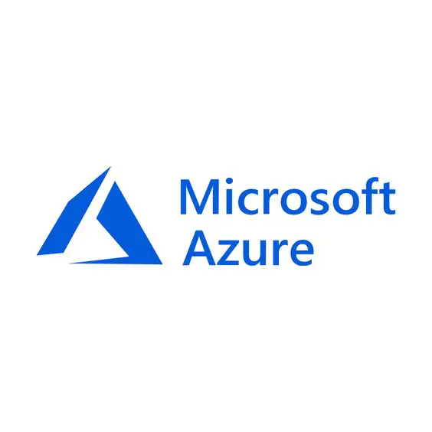

End-to-End Data Engineering Pipeline And Visualization
📊 Using Azure Data Factory, Databricks, Synapse Analytics & Power BI
👨‍💻 Presented by: Adharsh U 🎓 Internship Project – Lovely Professional University 📅 June 2025

Slide 2
Project Title: End-to-End Data Engineering Pipeline and Visualization
During my internship, I contributed to a data engineering project aimed at solving a common challenge many organizations face: making sense of large volumes of raw, unstructured data. Businesses often struggle to turn this data into meaningful insights quickly and efficiently, which can delay decision-making and affect performance.
To address this, our project focused on creating a streamlined data pipeline using Microsoft Azure tools. The goal was to automate the flow of data, from collecting raw information to generating useful insights for decision-makers.
We began by ingesting raw datasets into Azure Data Lake Storage, which served as the foundation for secure and scalable data storage. Using Azure Data Factory (ADF), we then orchestrated and automated data movement workflows. These pipelines ensured that data flowed seamlessly through the system with minimal manual intervention.
Next, data cleansing and transformation were carried out in Azure Databricks, leveraging the power of Apache Spark to handle large-scale data efficiently and in real-time. Once the data was processed and refined, it was loaded into Azure Synapse Analytics, which enabled high-performance querying and acted as a central data warehouse.
The final step was turning this data into clear, interactive dashboards using Power BI. These visualizations helped stakeholders easily understand patterns and trends, enabling them to make data-driven business decisions faster.
This project not only helped the organization improve its data handling and reporting processes but also gave me valuable, hands-on experience in using modern cloud-based tools for real-time data processing and visualization.

Slide 3
Azure Resource Group – Organizing the Project
A Resource Group is like a folder that contains all related Azure services.
It helps to organize, manage, and monitor resources as one unit.
In this project, I created a single Resource Group to keep everything (Data Lake, ADF, Databricks, Synapse) connected and manageable.
Azure Data Lake Gen2 – Secure Data Storage
Azure Data Lake Gen2 is used to store raw data securely in folders and files.
It supports hierarchical namespaces, making it easier to organize and access data.
ADF was connected to Data Lake to read raw files and pass them to Databricks.

Slide 4
Azure Data Factory – Data Orchestration
Azure Data Factory (ADF) connects to diverse data sources. It moves data into Azure. ADF acts as a powerful pipeline tool. It automates data flow from storage to processing layers. For example, I used ADF to copy data from Azure Data Lake into Databricks for processing.

Slide 5
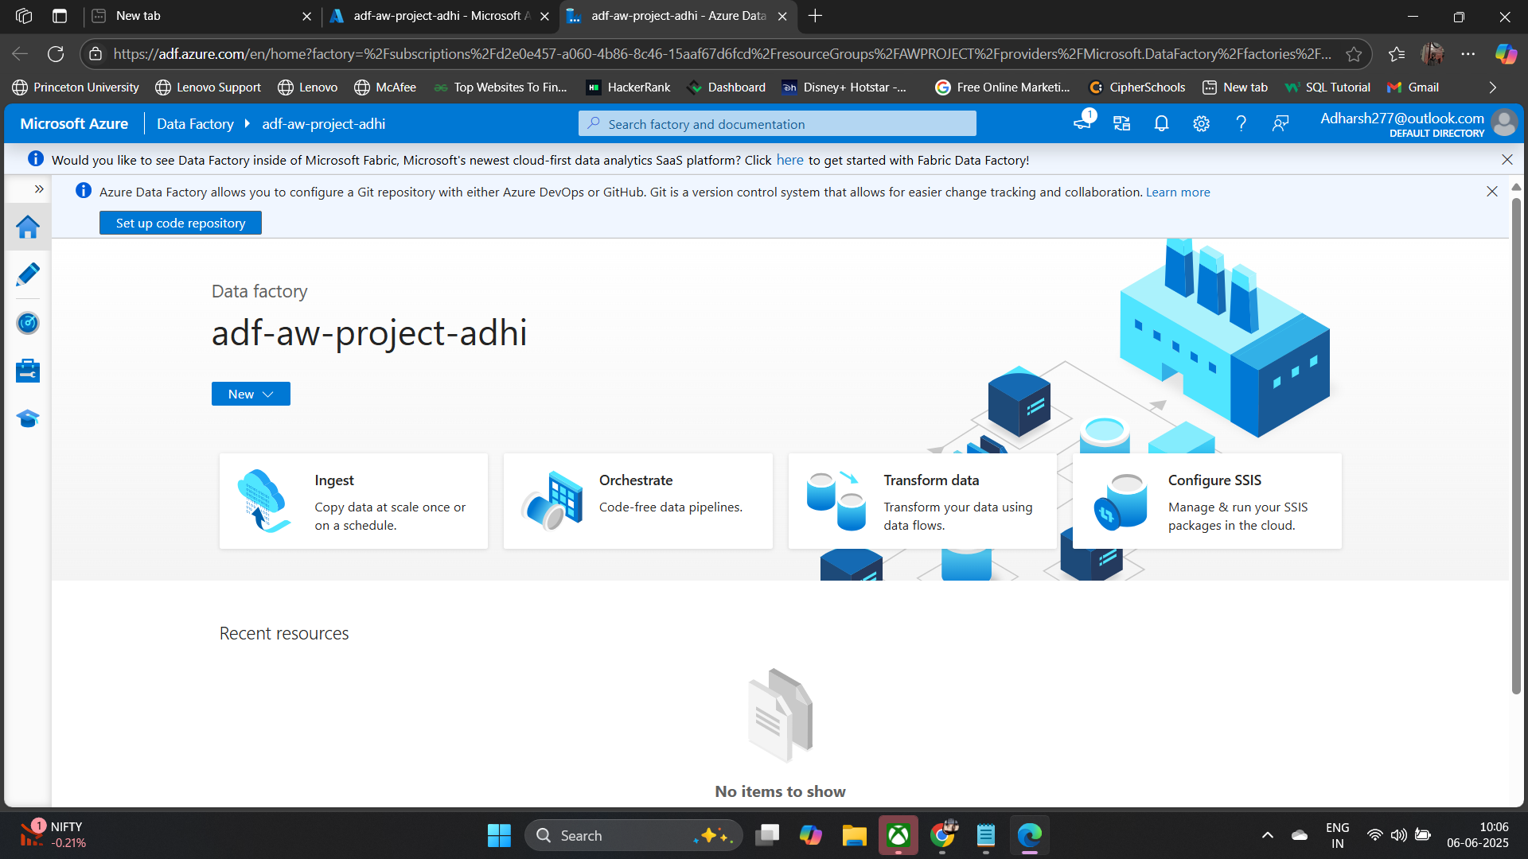
This is where I created the Azure Data Factory instance and designed the pipeline to orchestrate the data flow

Slide 6
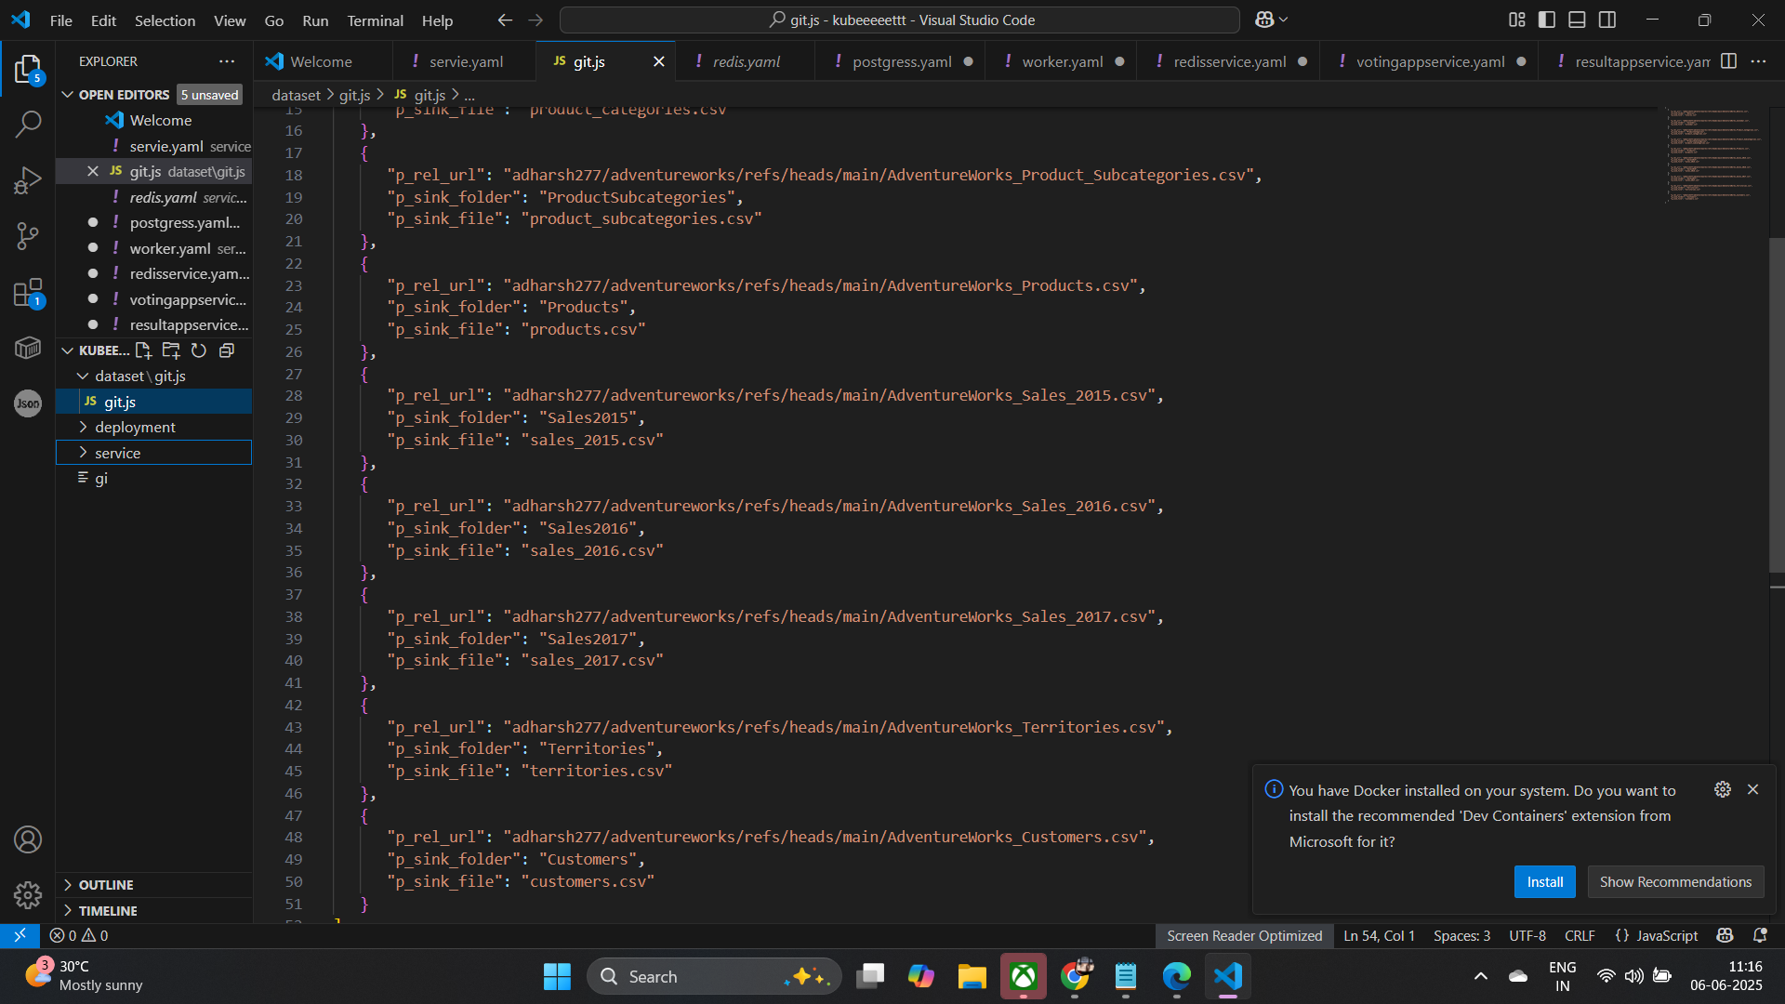
Shown here is the JSON definition of a parameterized ADF pipeline, which dynamically handles different datasets through user-defined parameters

Slide 7
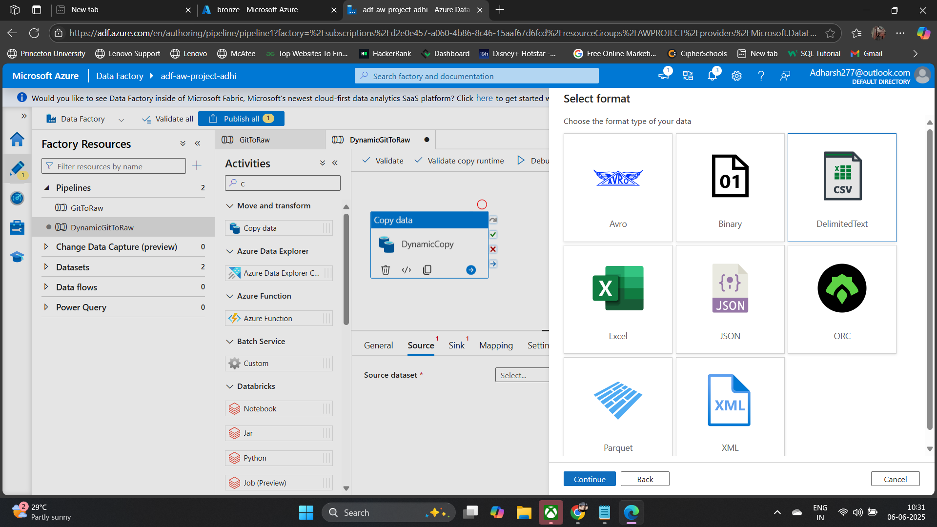



Slide 8
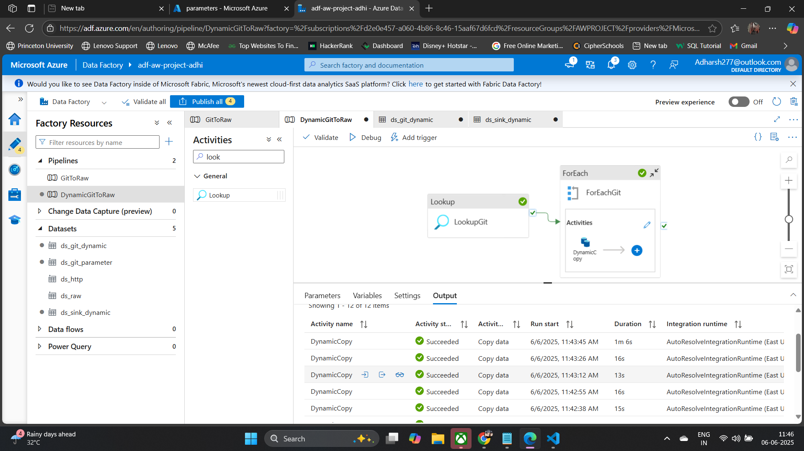

Slide 9

Azure Databricks – Data Processing with Apache Spark
Azure Databricks leverages Apache Spark for powerful data cleaning, filtering, and transformation. It scales data processing on Azure infrastructure. This prepares data for efficient loading into Synapse Analytics.

Slide 10
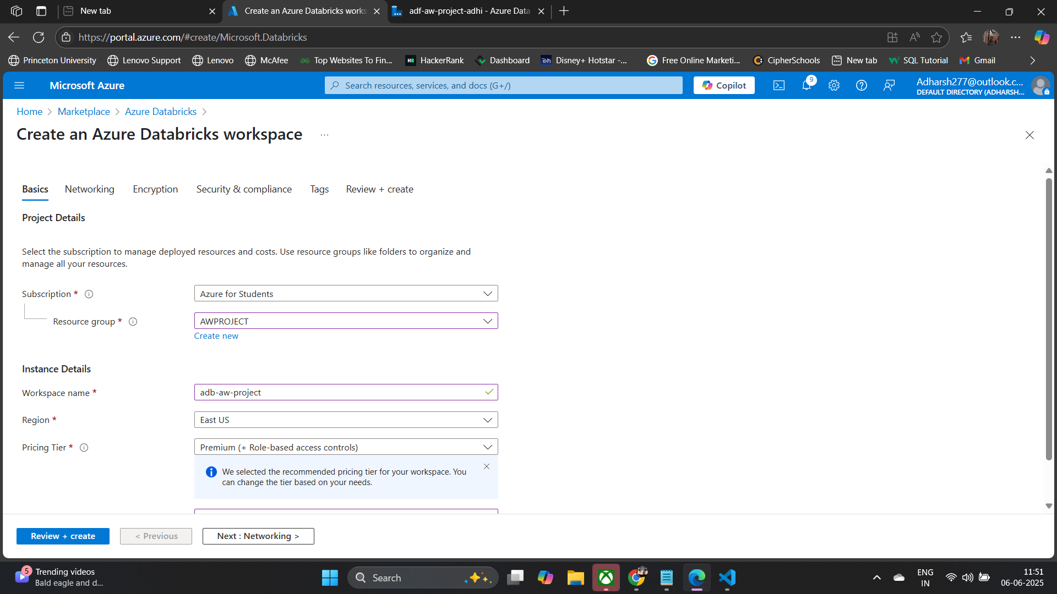

Slide 11
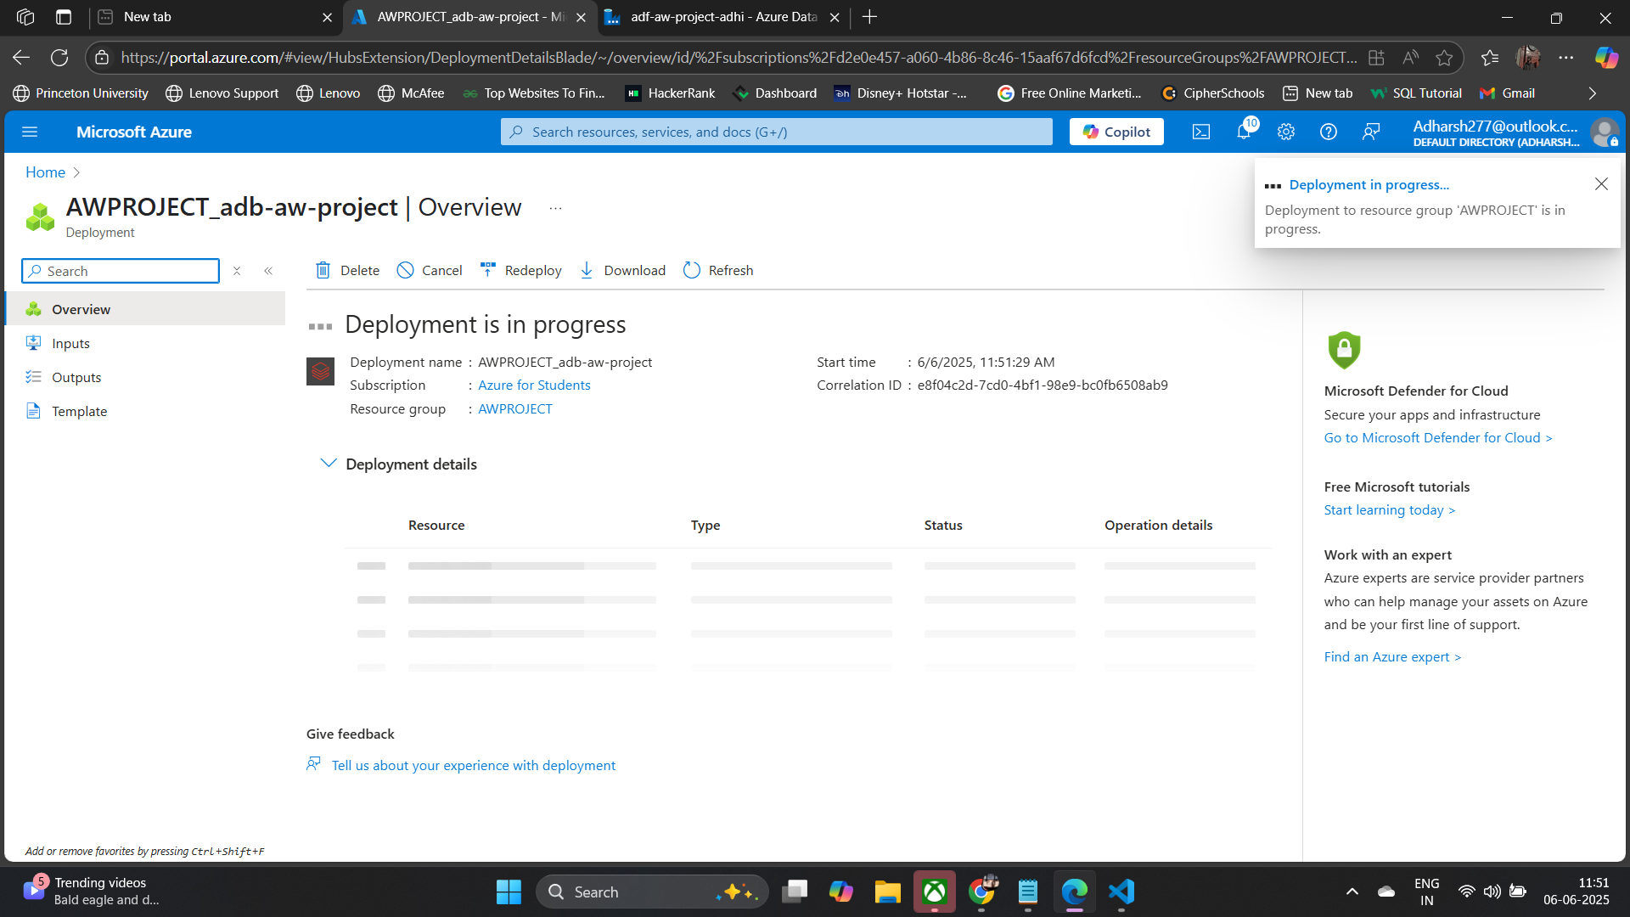

Slide 12
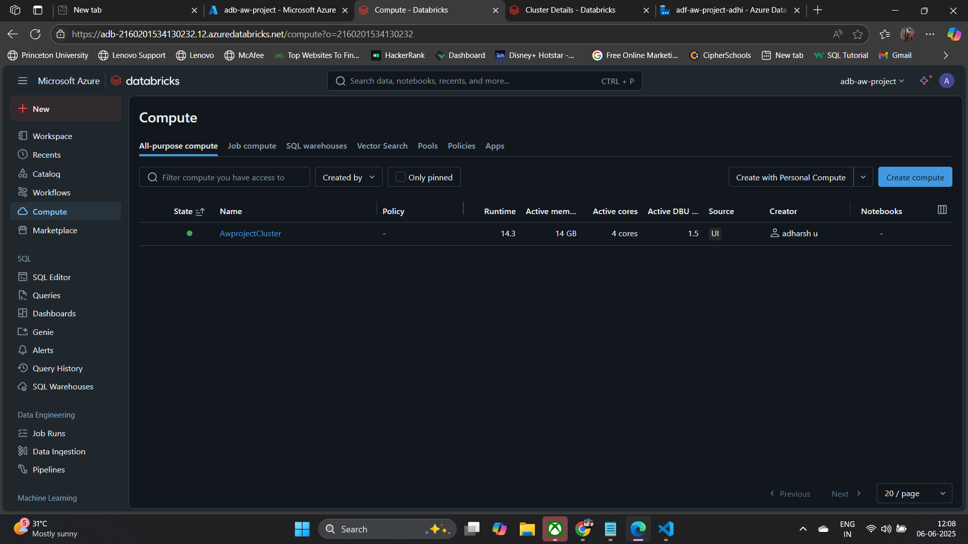

Slide 13
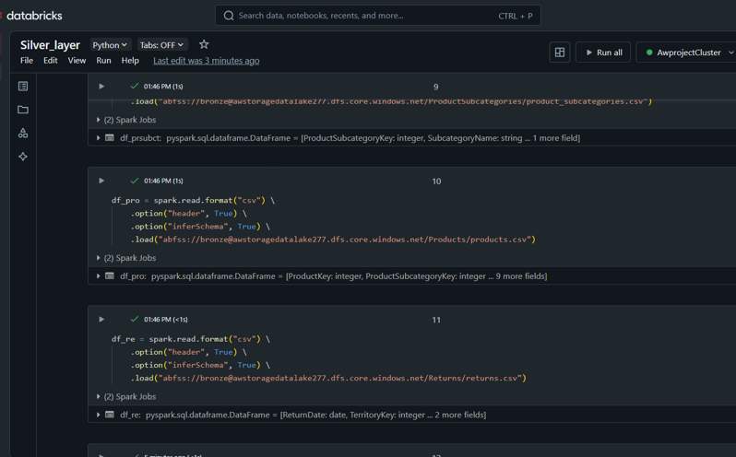
Transformation Example: PySpark Data Cleaning
Our objective is to clean and prepare a dataset for Synapse Analytics. We use PySpark for these crucial transformation steps.
Remove Nulls
Eliminate rows containing incomplete or null values.
Split Columns
Separate combined fields into individual, distinct columns.
Change Data Types
Adjust data types for compatibility with Synapse Analytics.

Slide 14
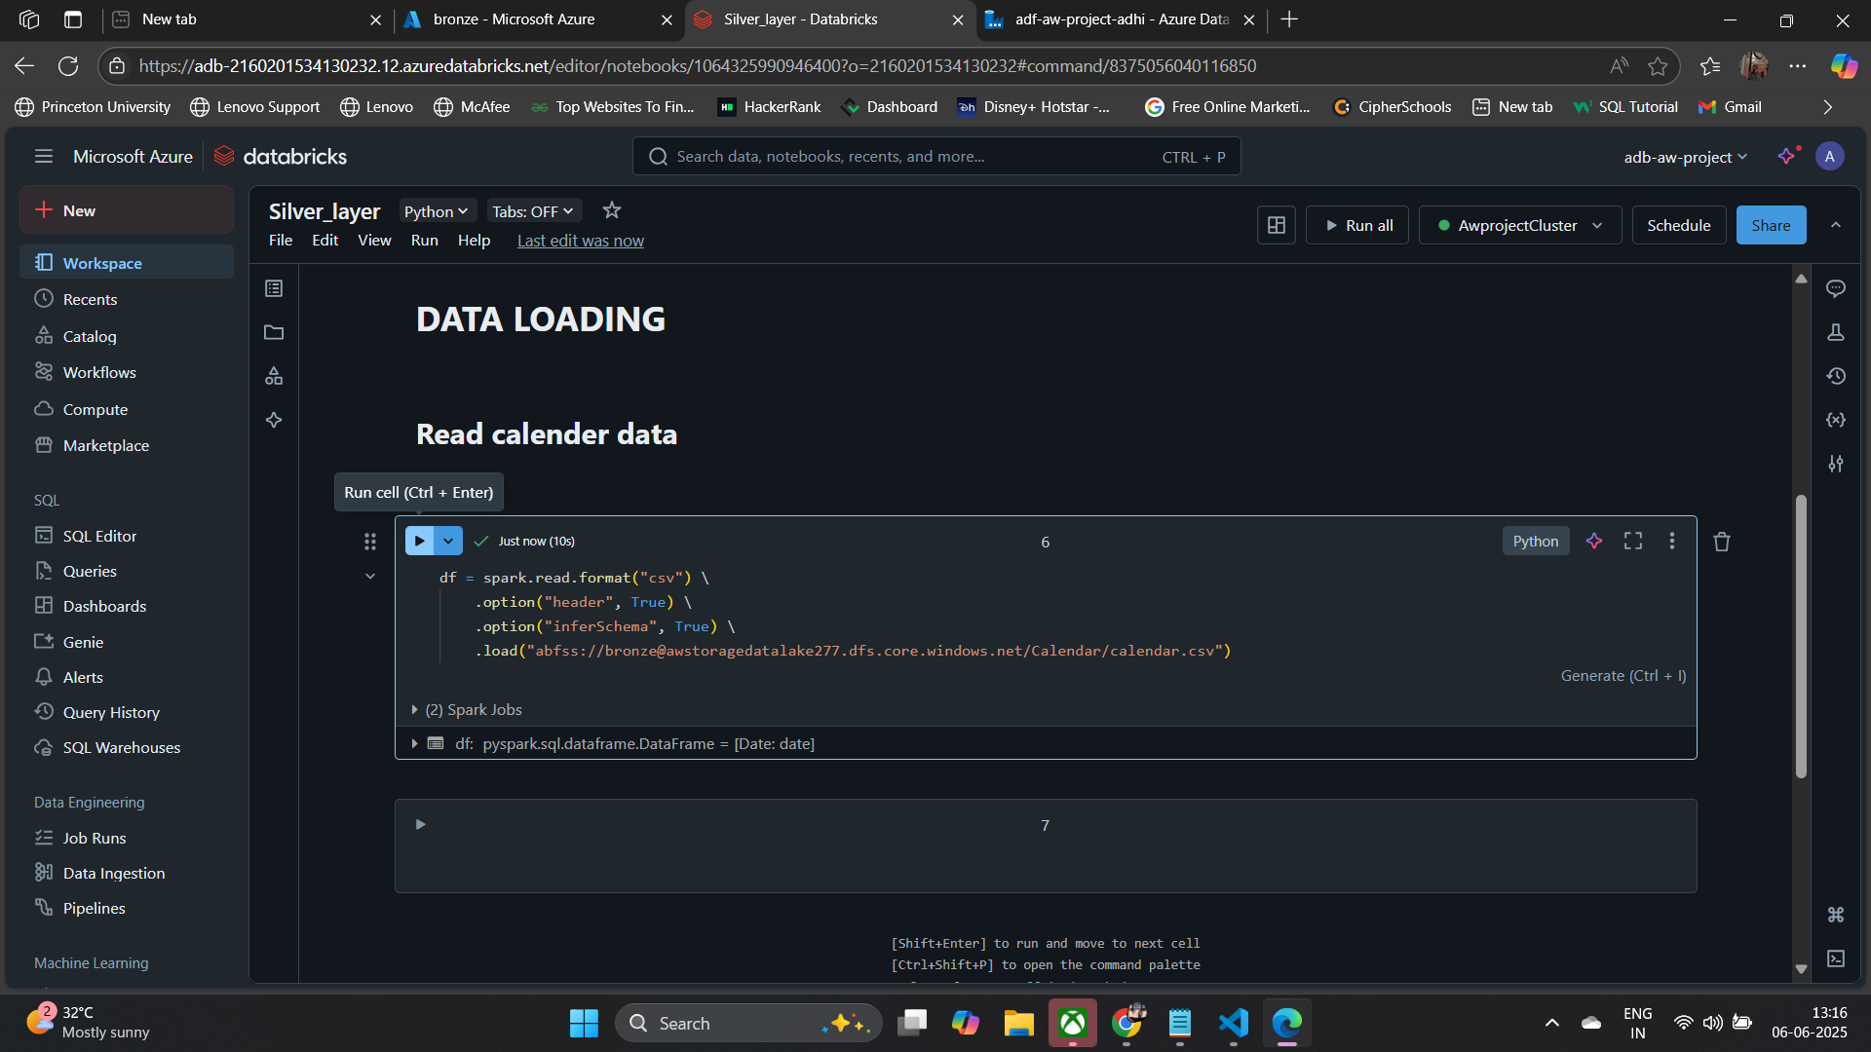

Slide 15
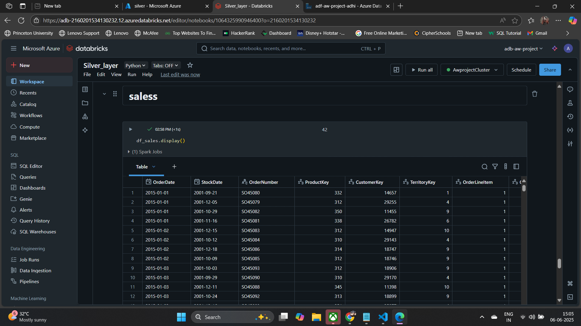

Slide 16
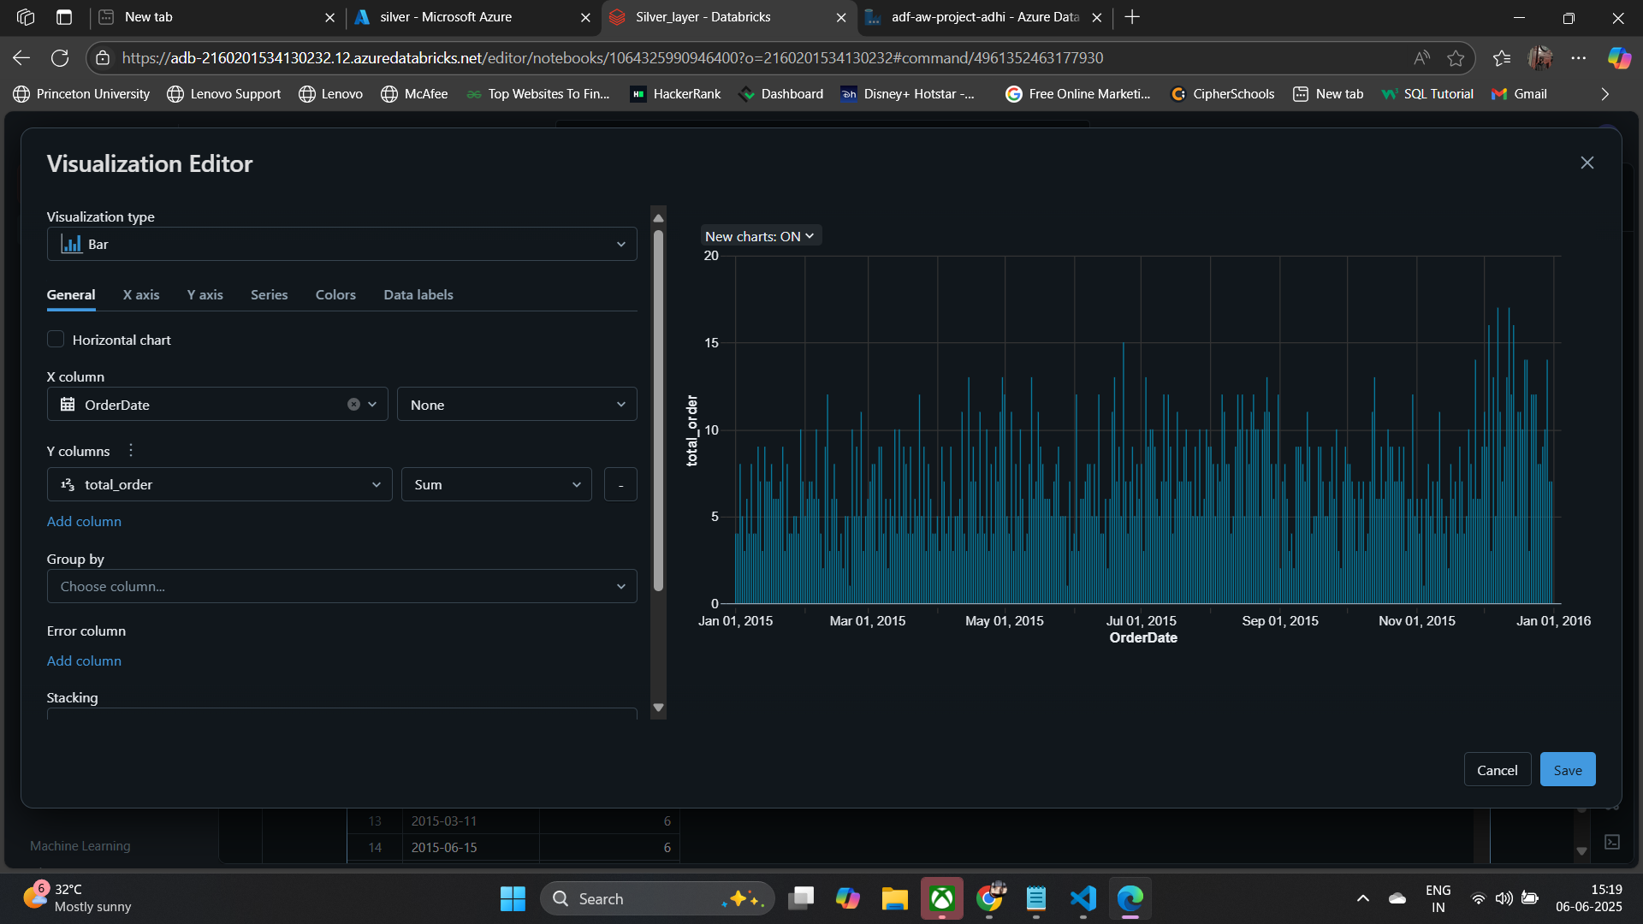

Slide 17
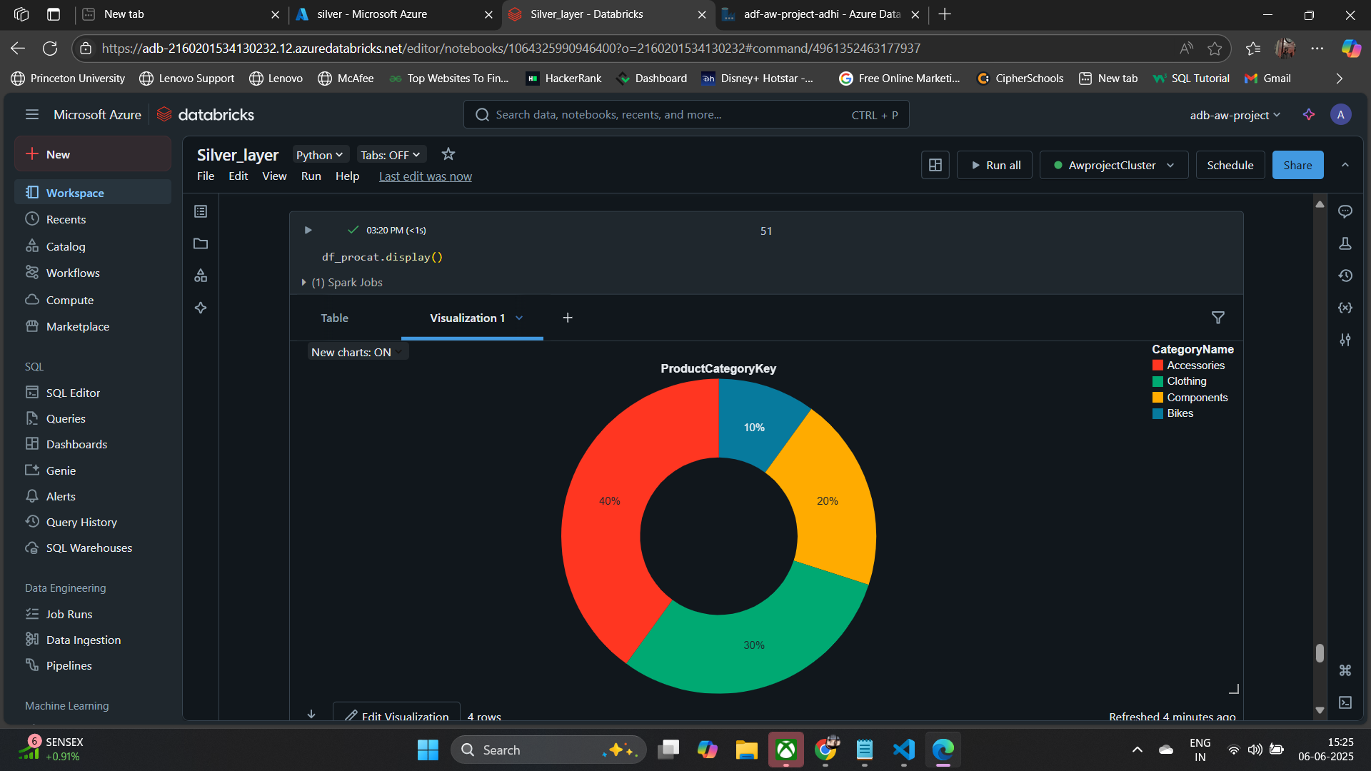

Slide 18
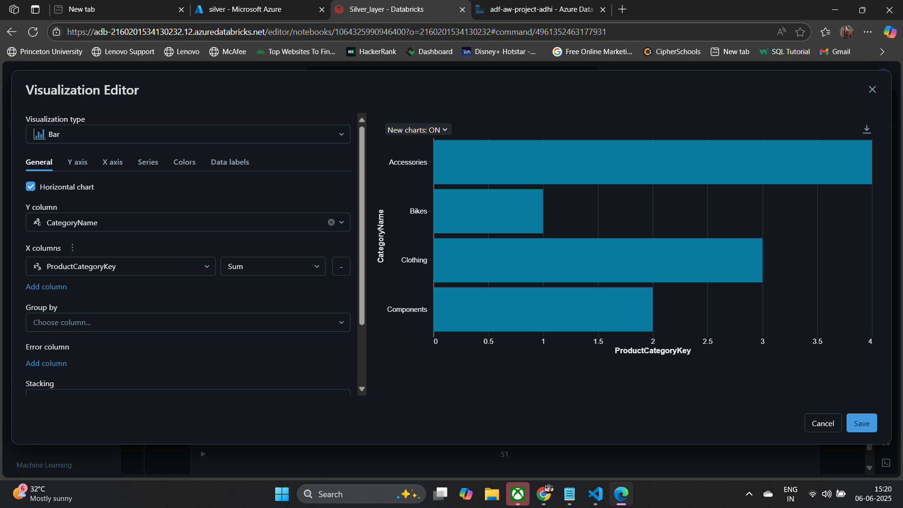

Slide 19

Azure Synapse Analytics – Centralized Data Warehouse
Azure Synapse Analytics unifies data warehousing and big data analytics. It stores final processed data in a structured format. This enables fast querying and Power BI visualization.

Slide 20

Storage & Query Details
Data Ingestion
Data from Databricks is ingested. It populates SQL views or tables.
Efficient Querying
A robust SQL interface allows fast queries. It ensures quick data retrieval.
Power BI Foundation
The structured data forms the base. It supports interactive Power BI dashboards.

Slide 21
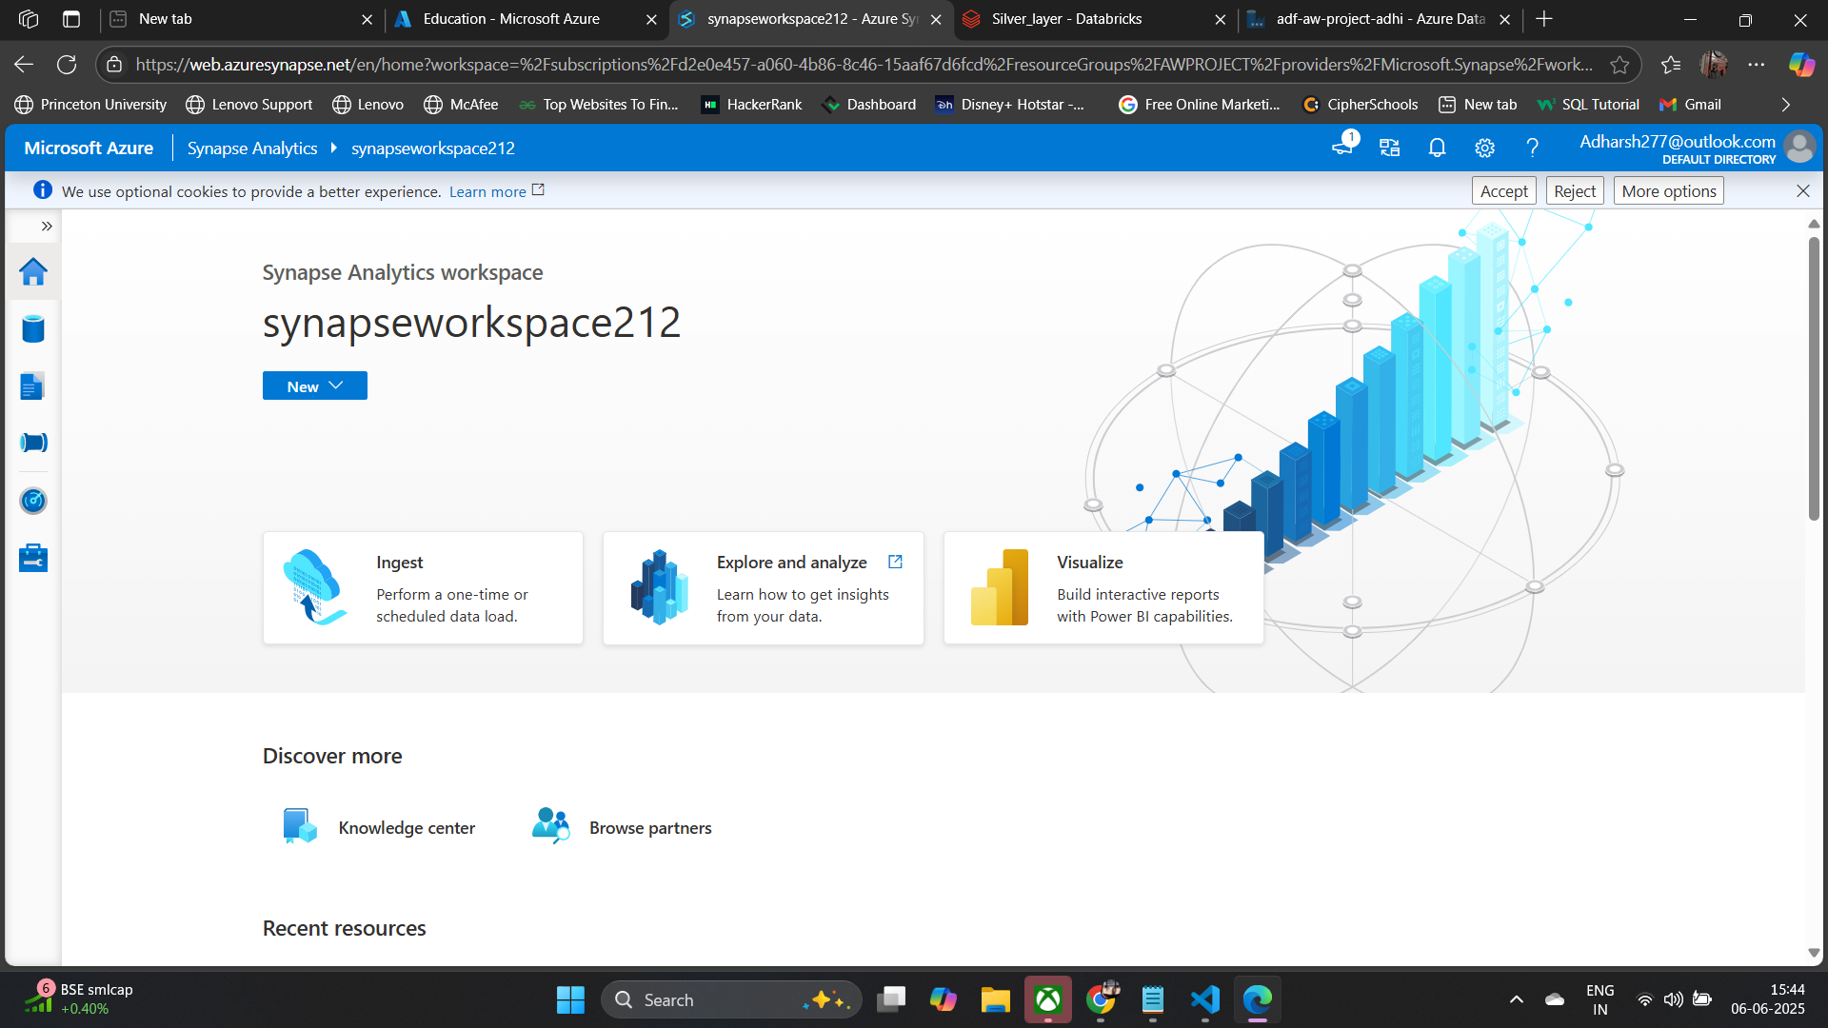

Slide 22
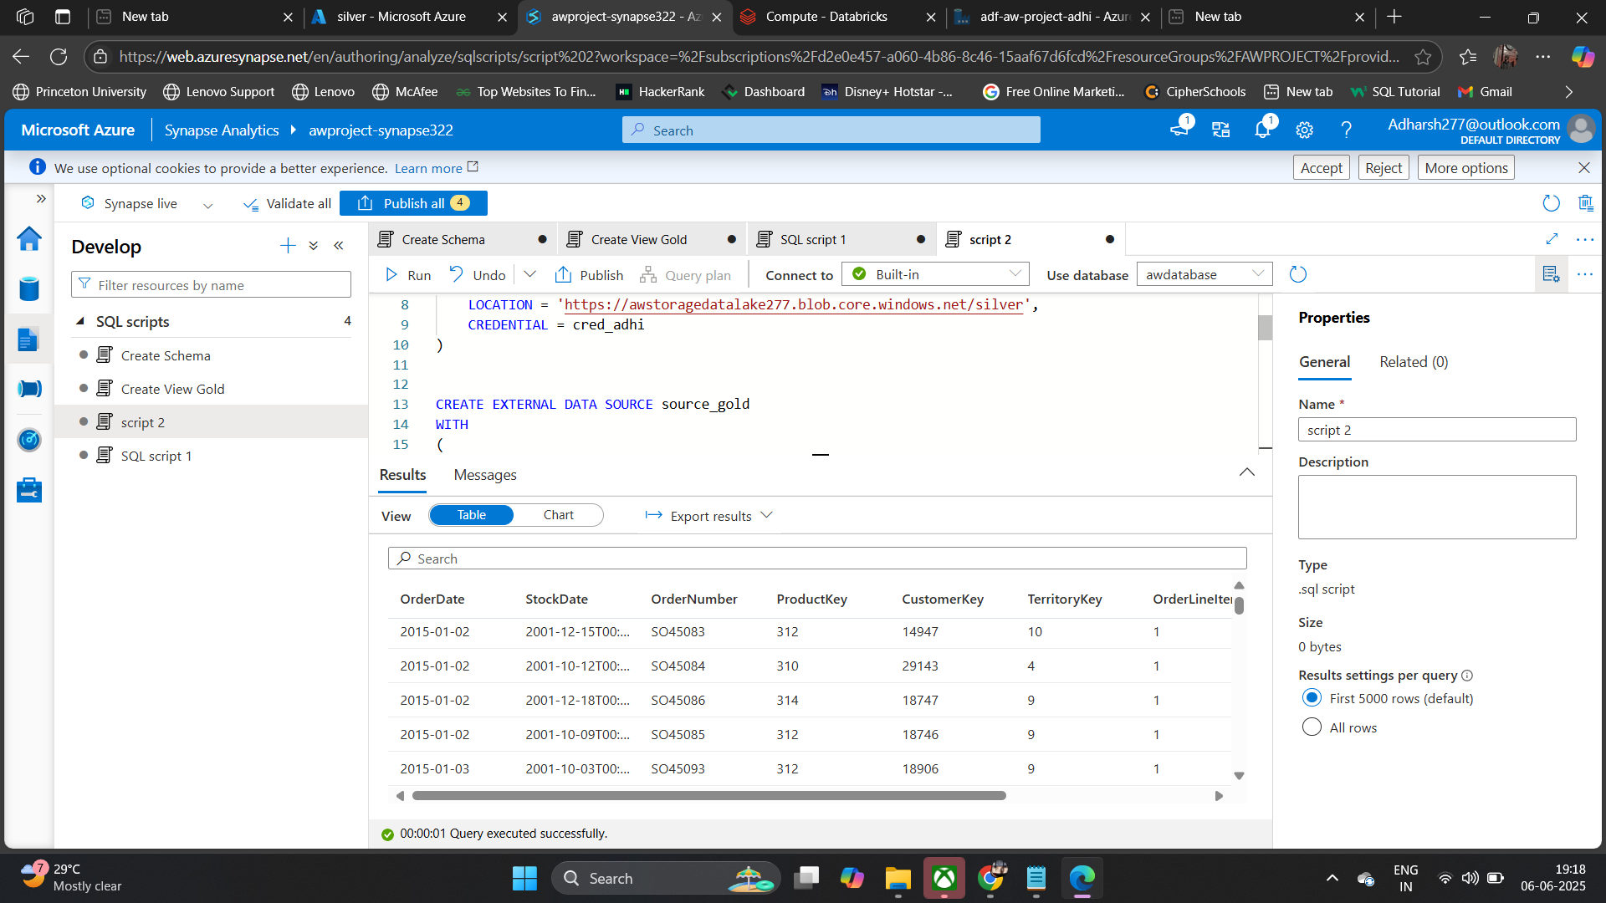

Slide 23
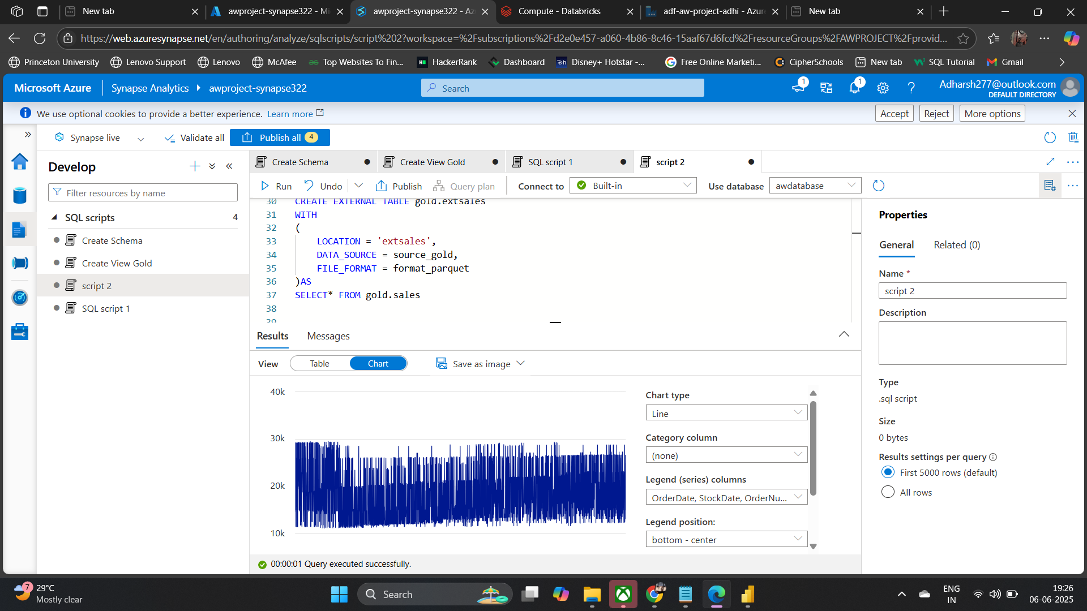

Slide 24

Power BI – Data Visualization
This presentation explores how Power BI transforms raw data into compelling visual stories. We'll examine its role in creating interactive dashboards and charts.

Slide 25

Power BI and Synapse – A Powerful Combination
Synapse as Data Source
Real-time Insights
Synapse provides a robust data source for Power BI. It ensures seamless integration with complex datasets.
This combination enables real-time monitoring. It drives informed, data-driven decisions.

Slide 26
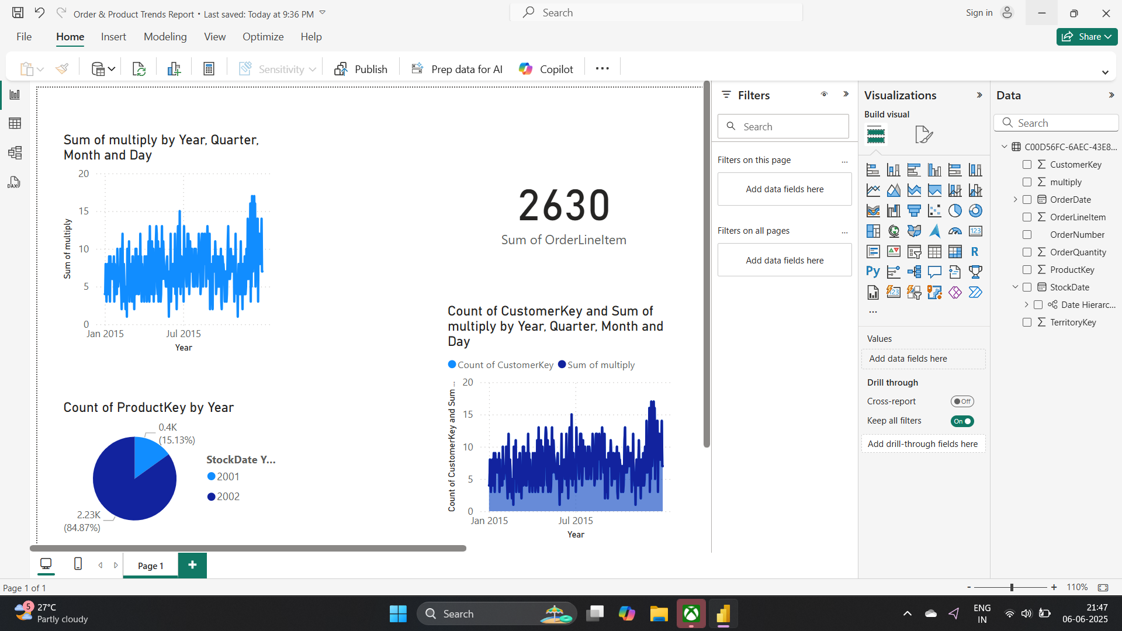

Slide 27
The end

